Slide 1
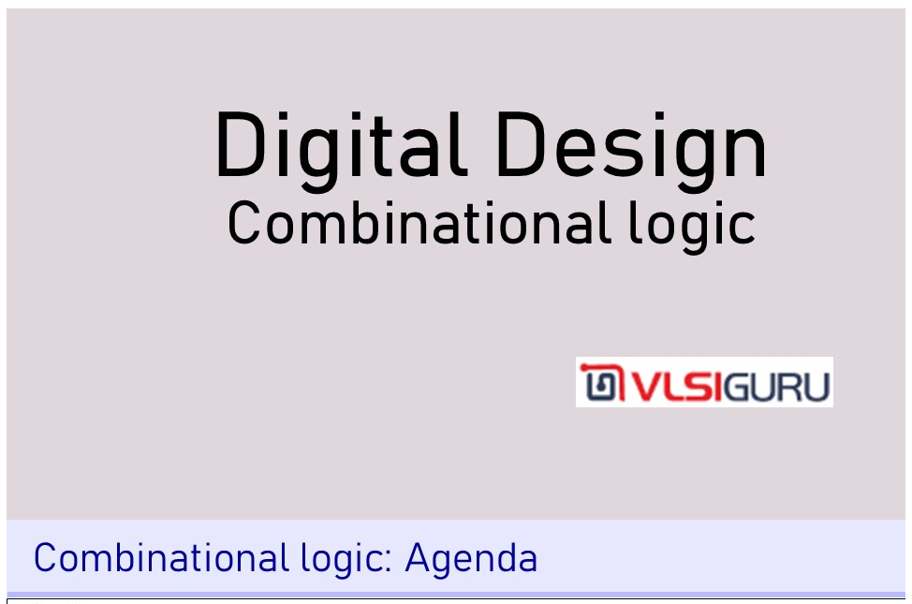

Slide 2
Unit 3: Number system and radix format and hex to binary mapping

Slide 3
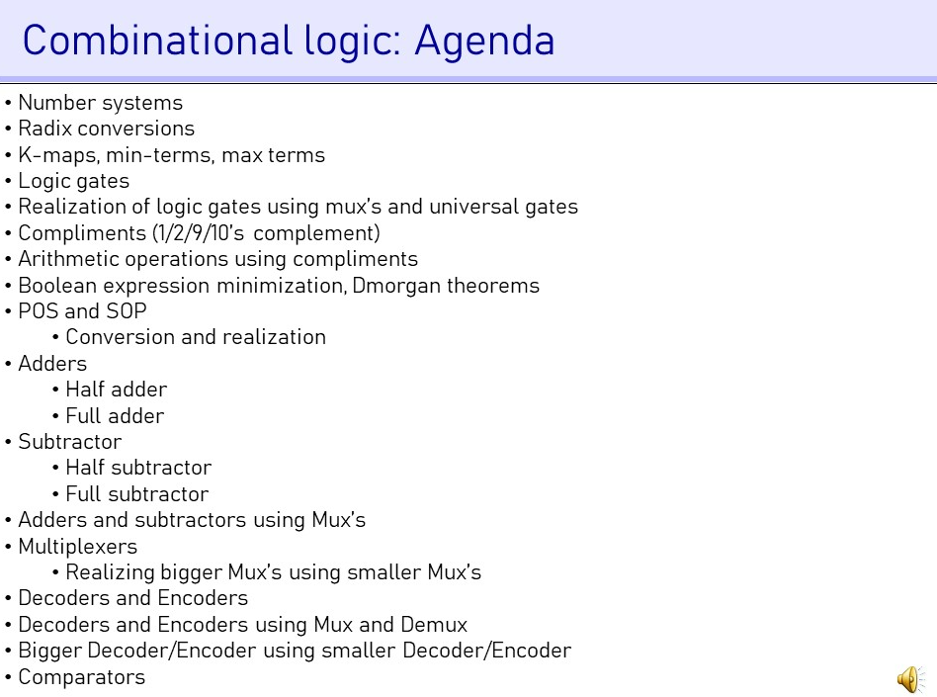

Slide 4
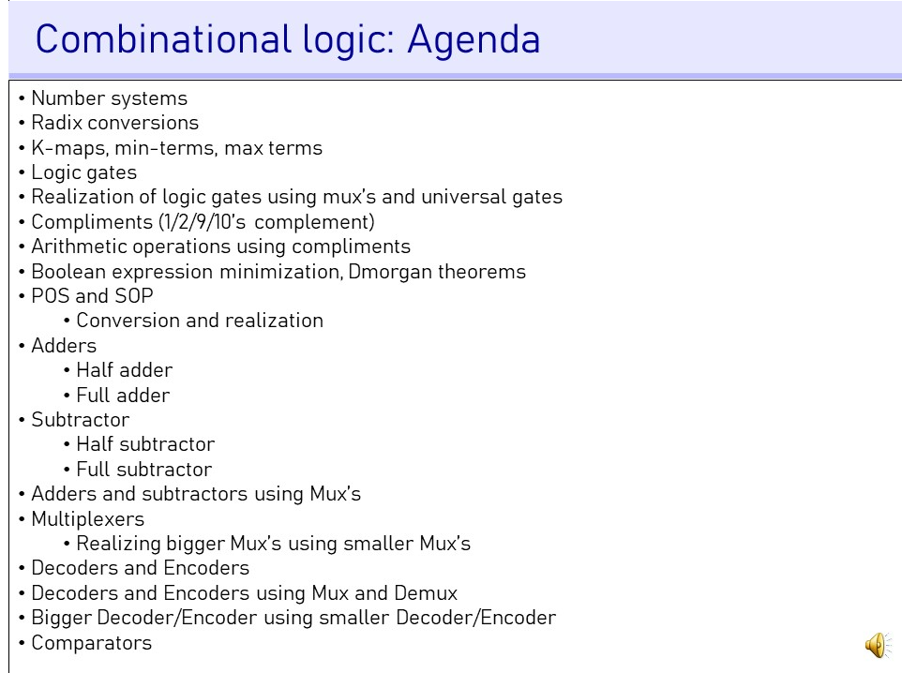

Slide 5
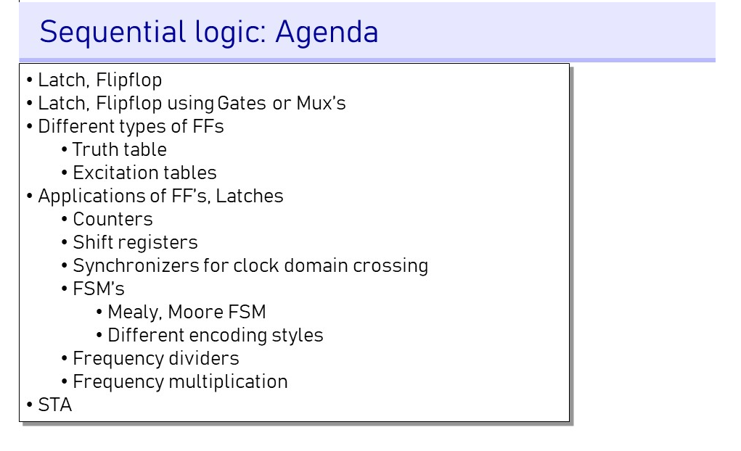

Slide 6


Slide 7
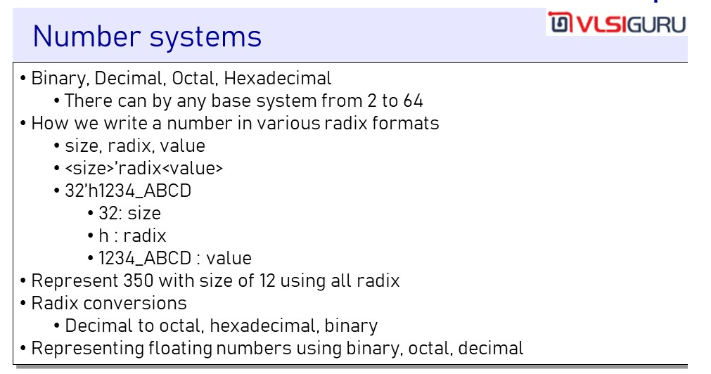

Slide 8
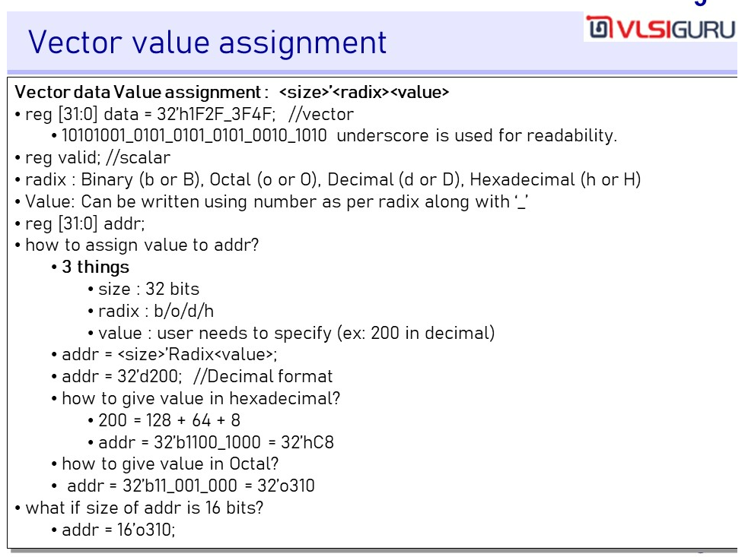

Slide 9


Slide 10
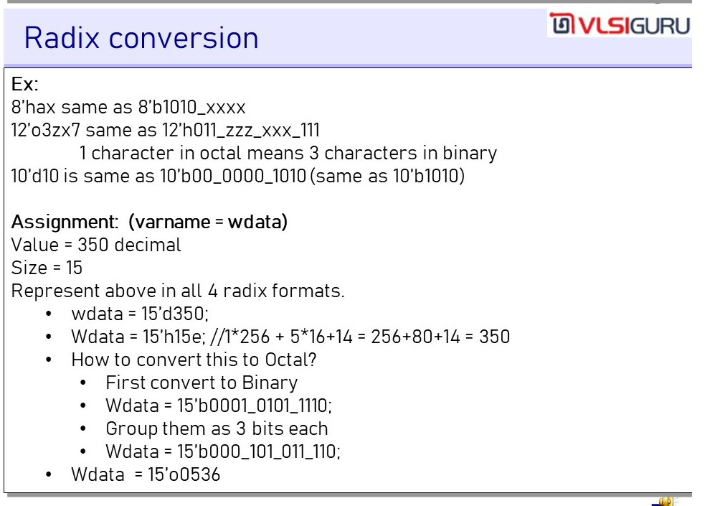

Slide 11
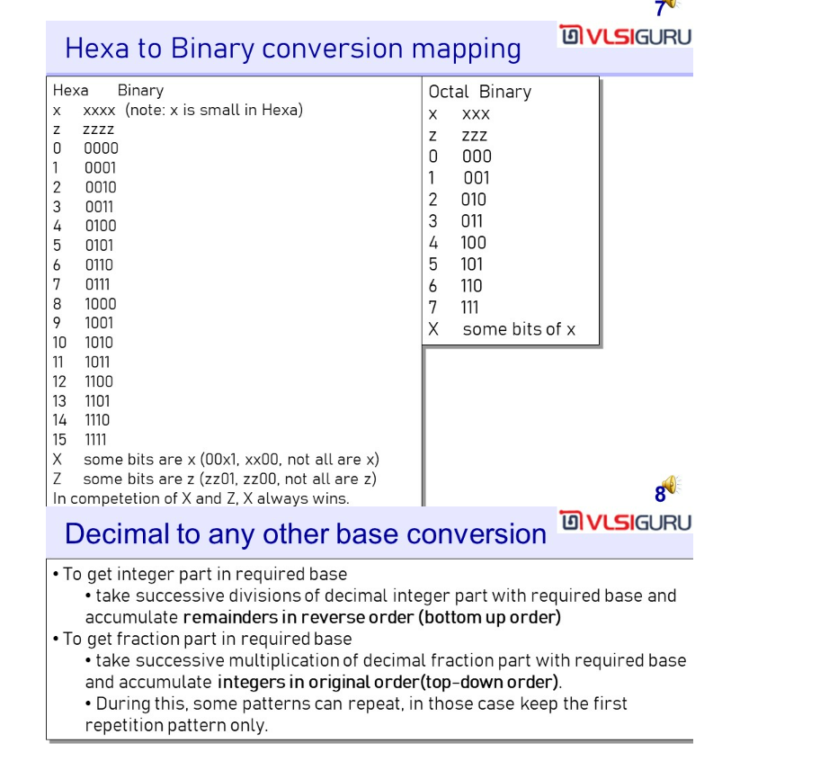

Slide 12
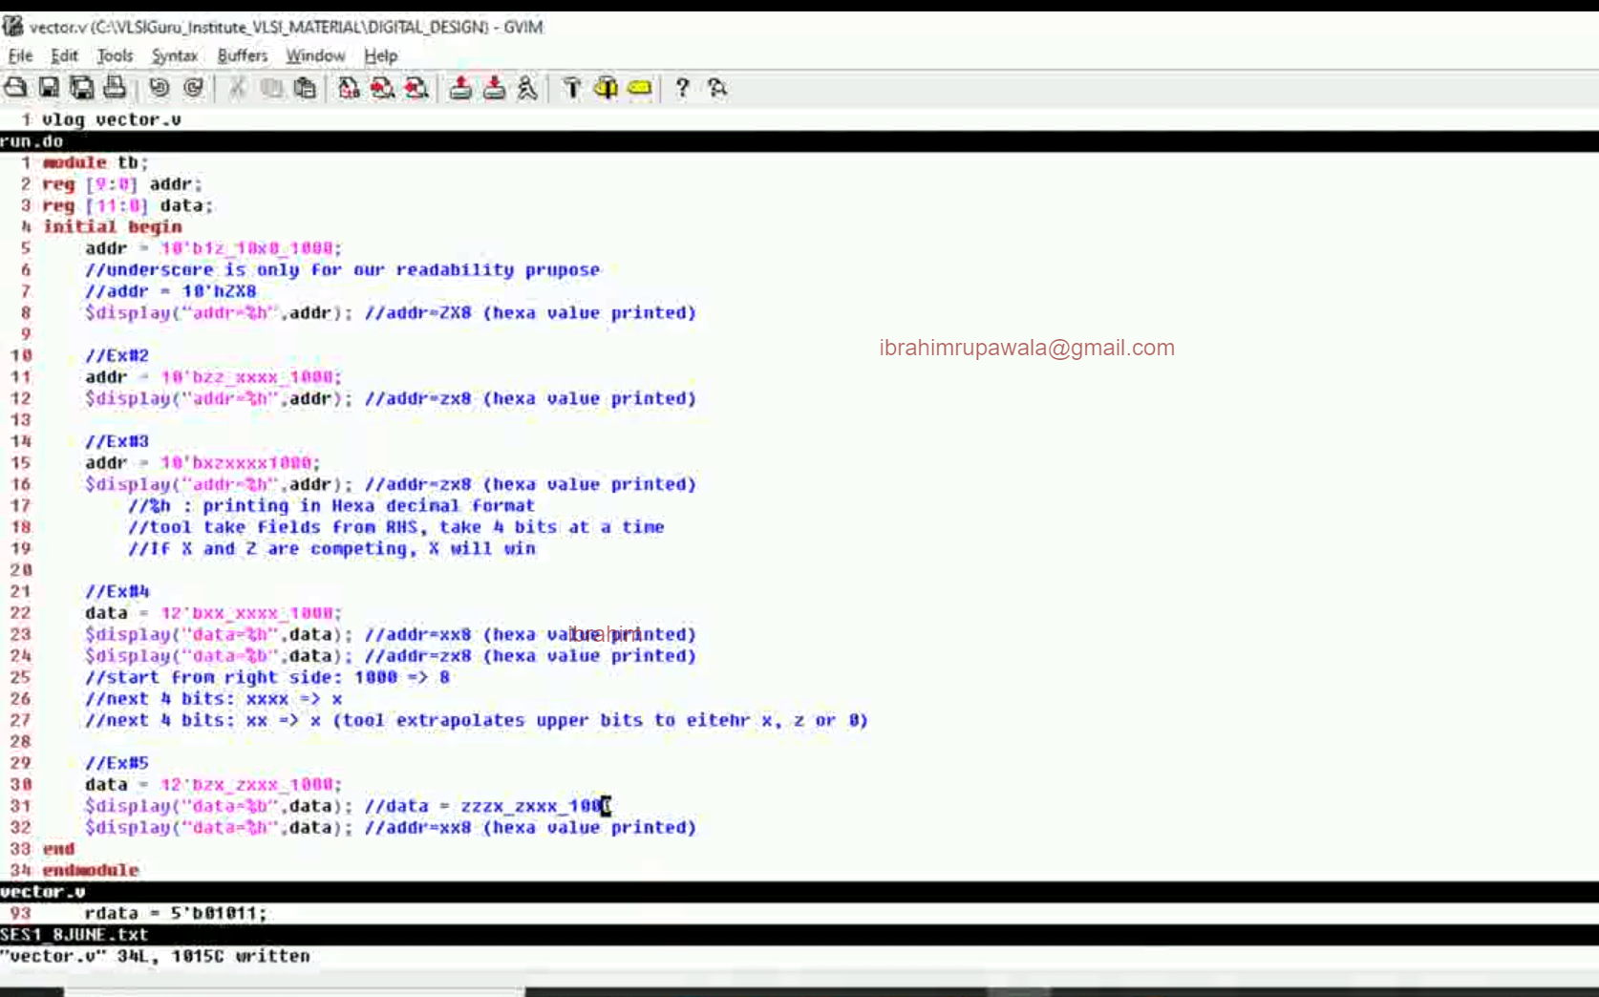
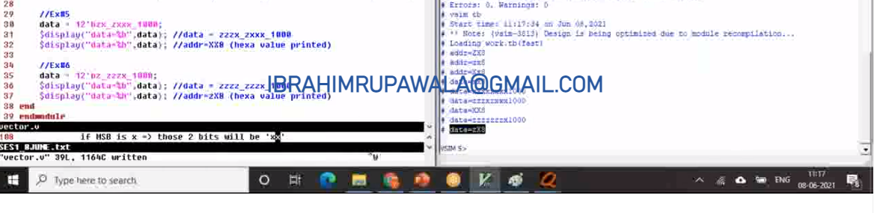

Slide 13
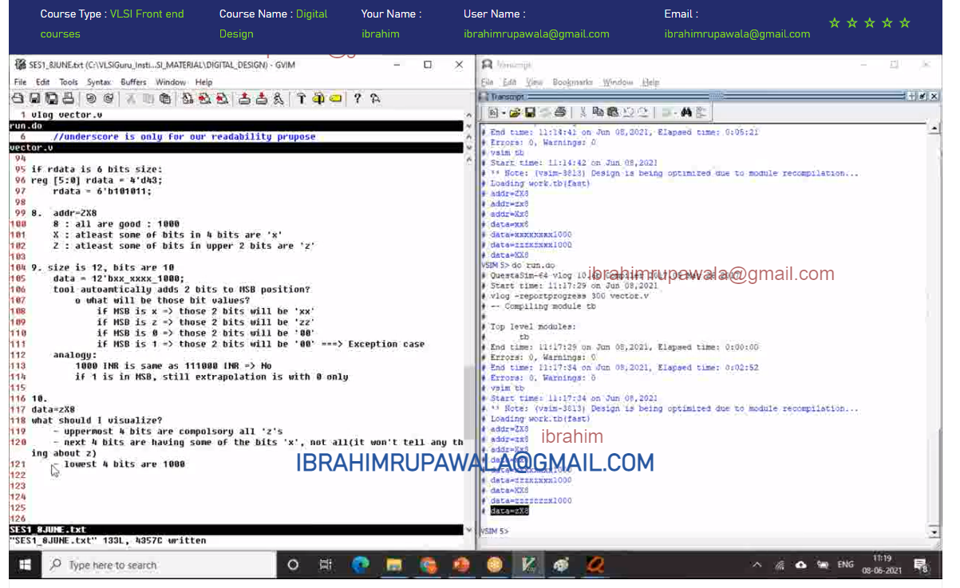

Slide 14
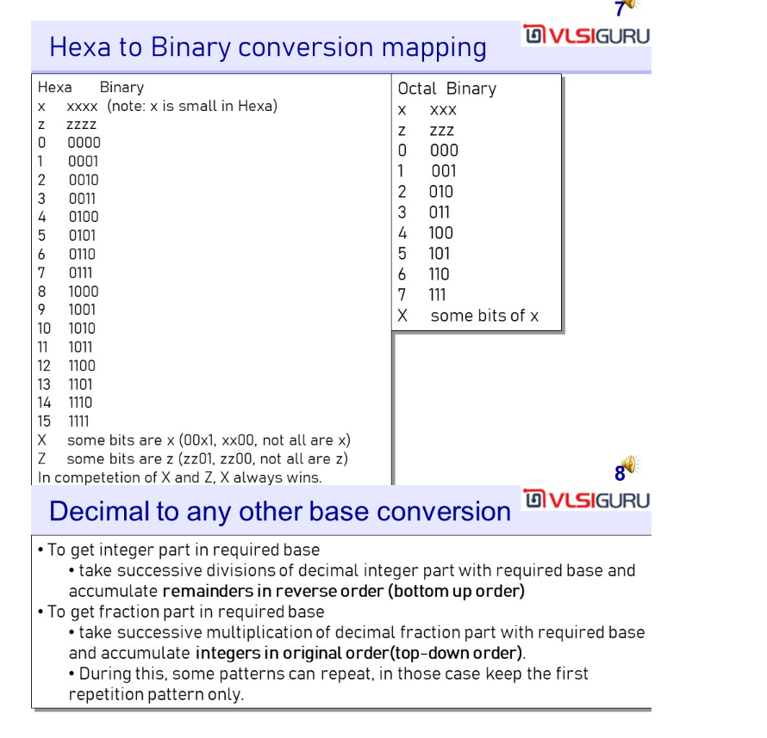

Slide 15
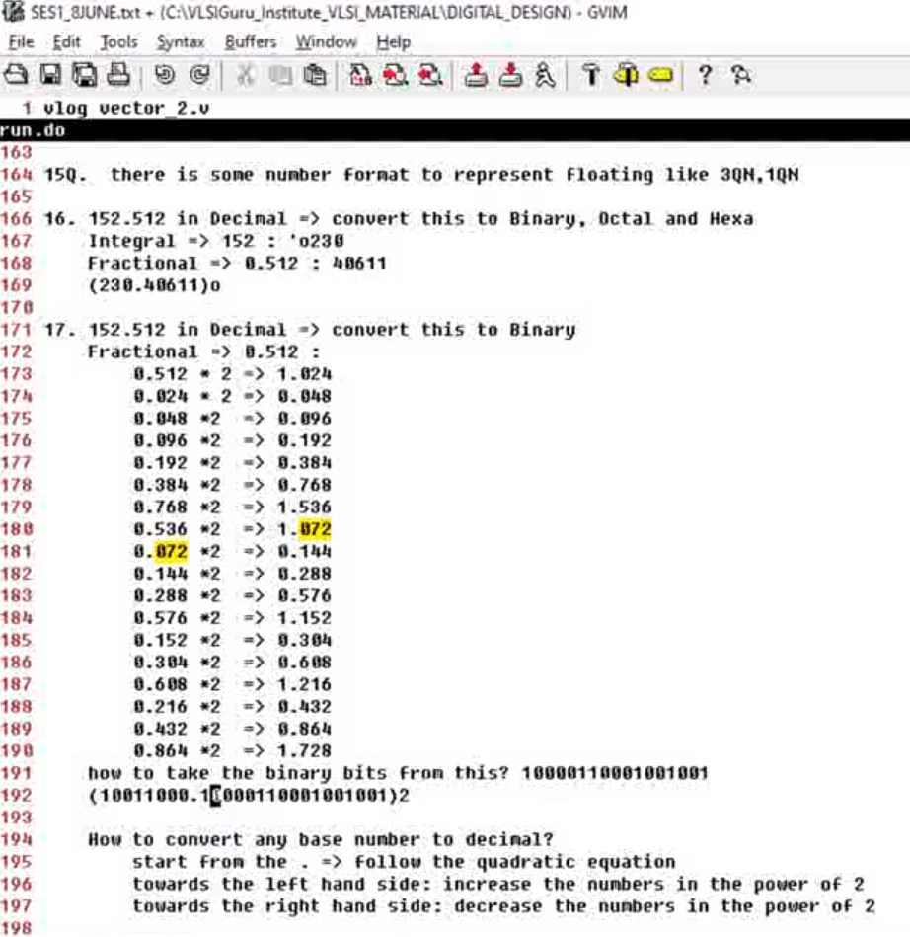
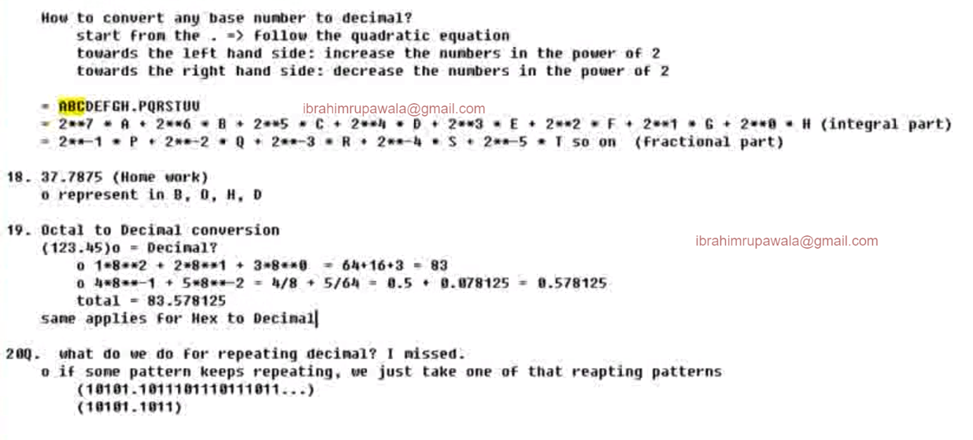
This is very important. See how to represent any base number to decimal

Slide 16
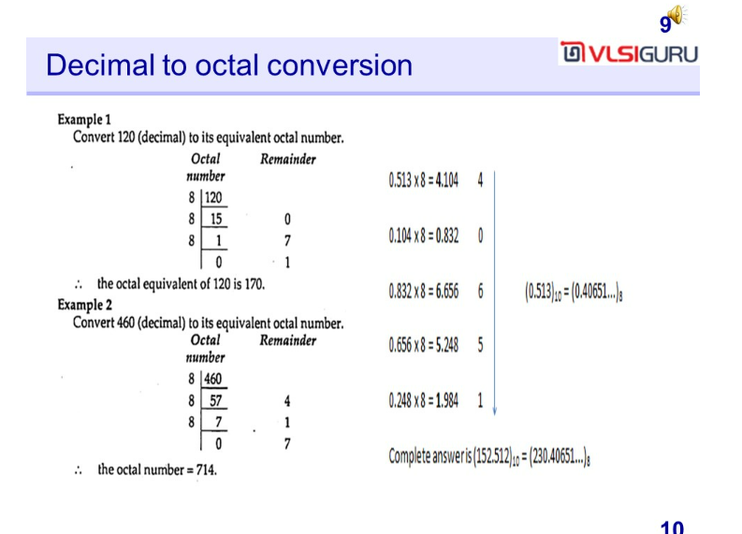

Slide 17
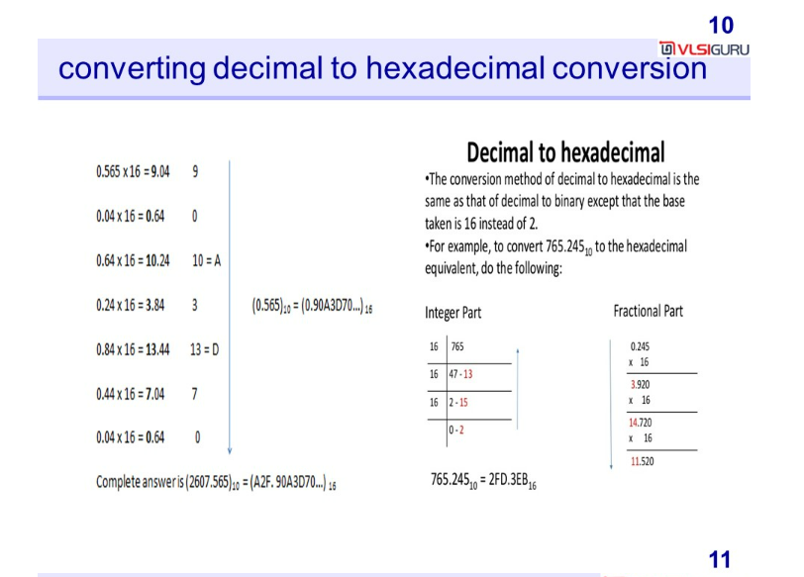

Slide 18
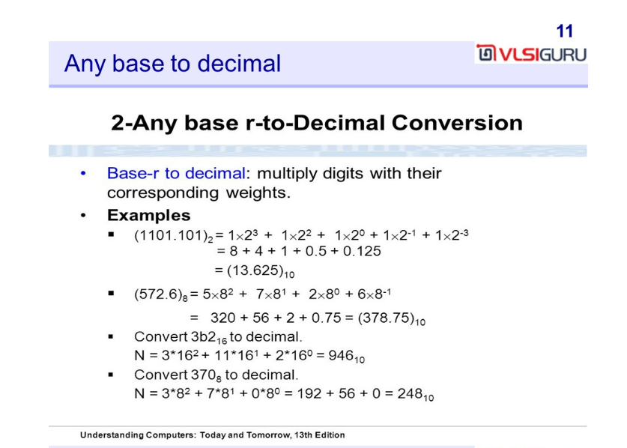

Slide 19
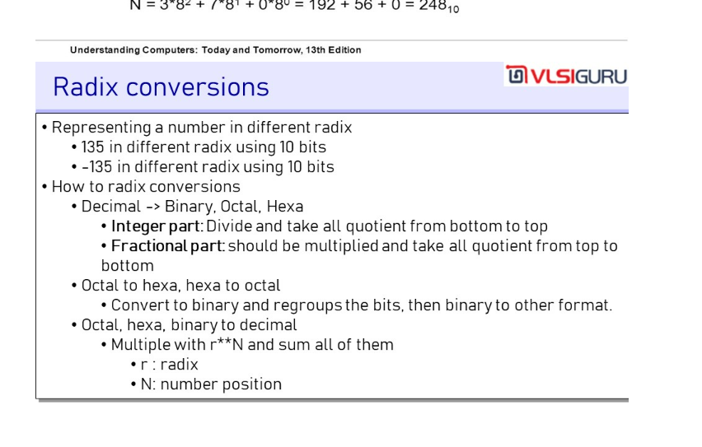
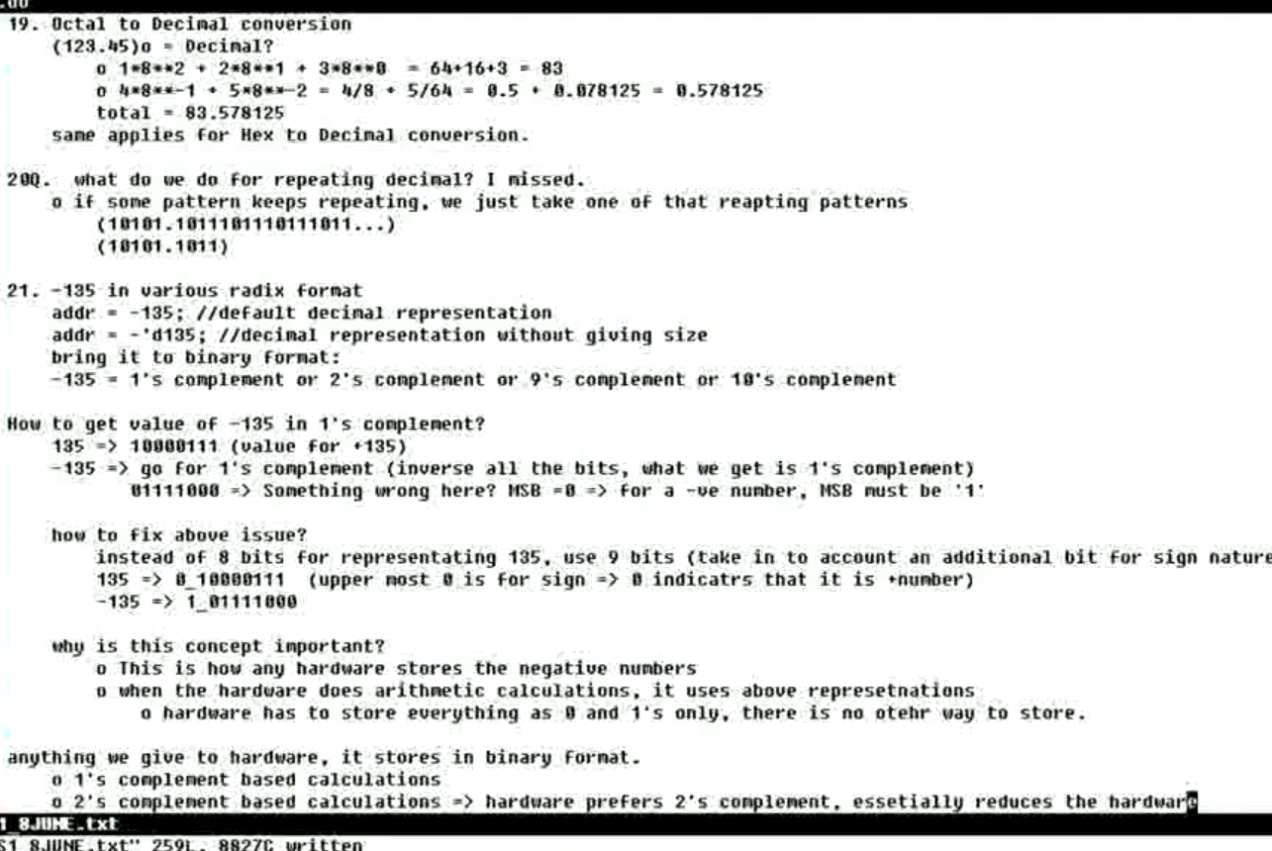

Slide 20
Unit 4: Number of bits required and compliments

Slide 21
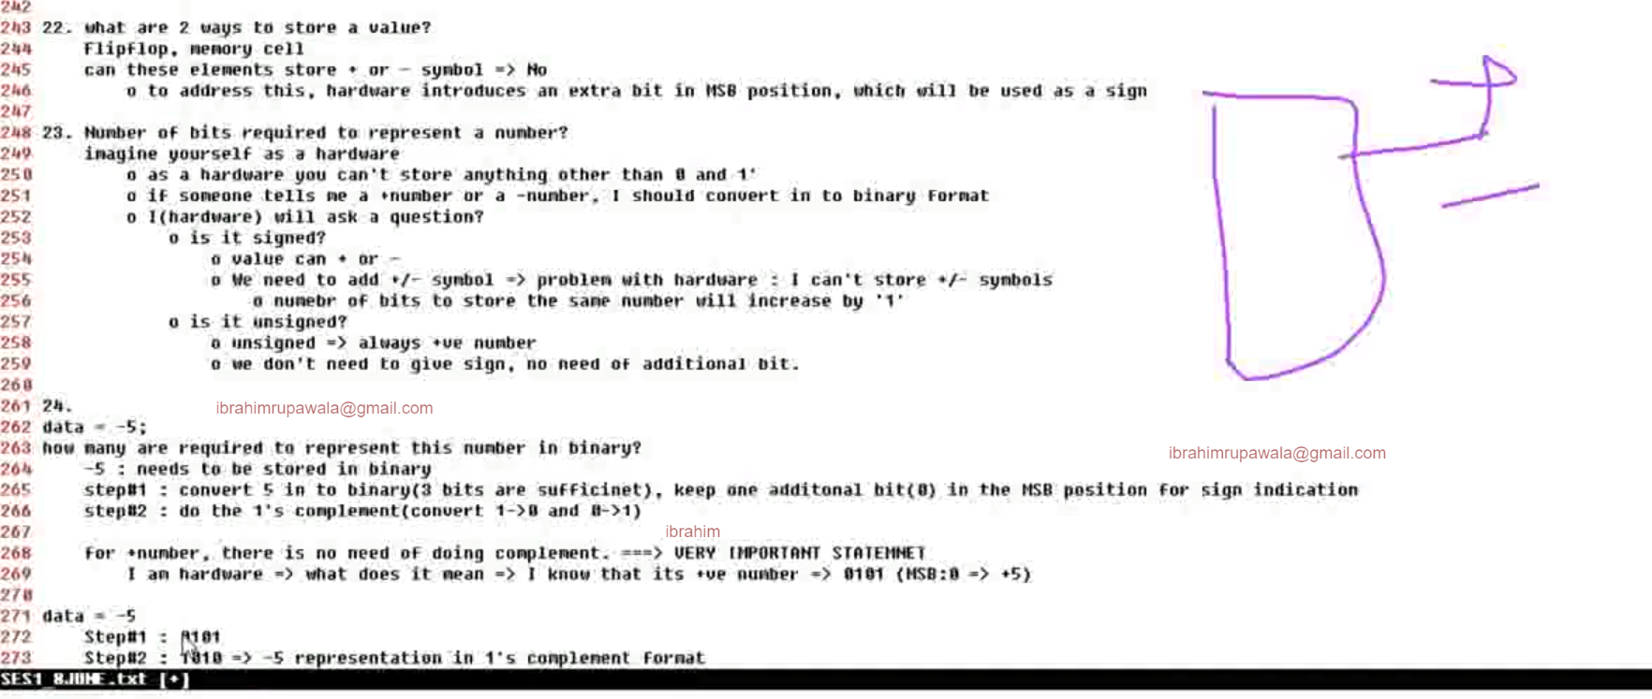
A FF can only store 1 bit, hence 8-bit hardware consist of 8 FF’s.
What are 2 ways to store a value ? – Flipflop and Memory cells.

Slide 22
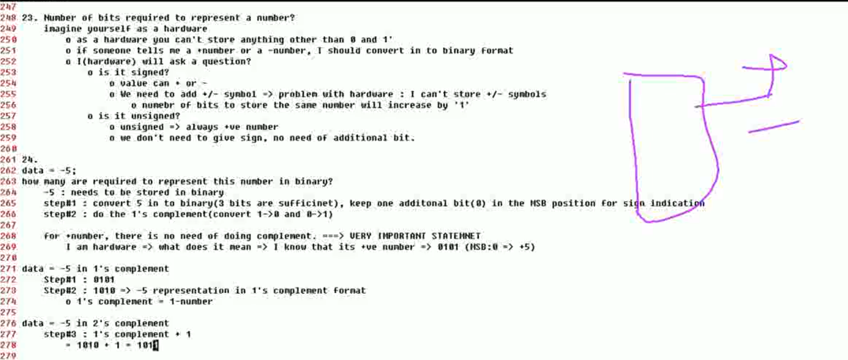

Slide 23
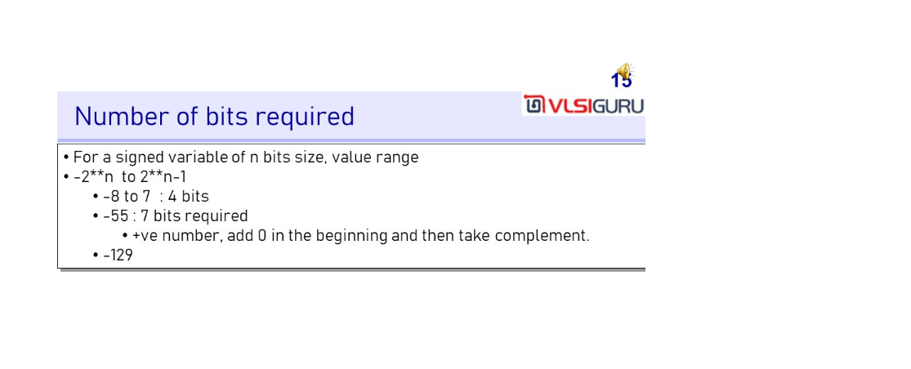
Notice that Verilog stores the number in 2’s complement form

Slide 24
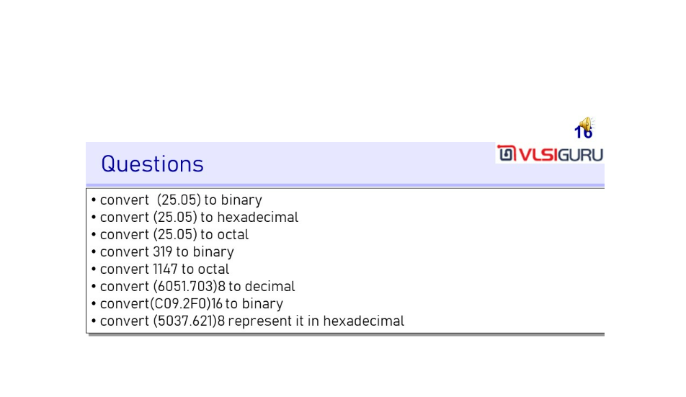

Slide 25
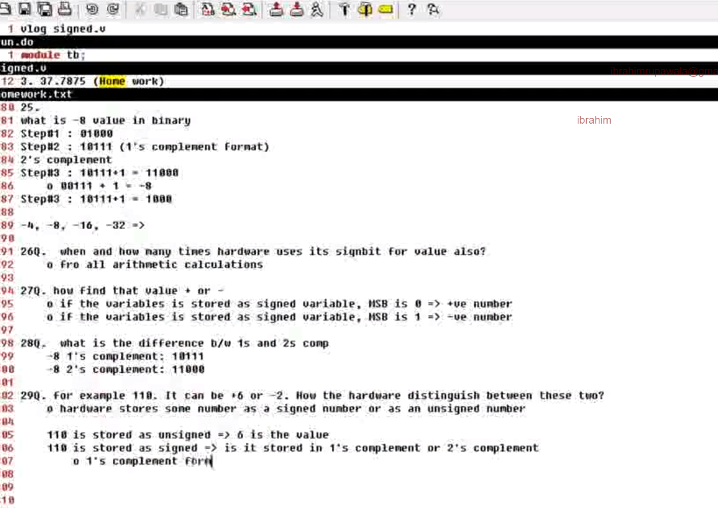
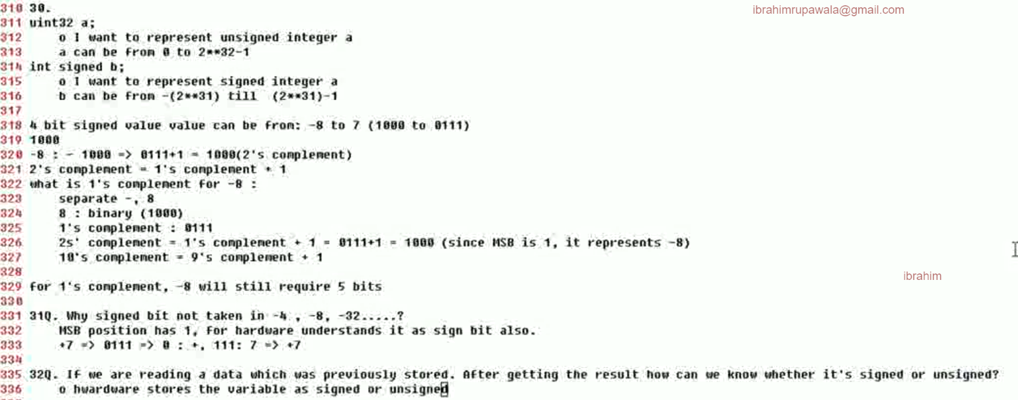

Slide 26
Remember that negative number is stored always in 2’s complement in verilog
// Code your testbench here
// or browse Examples
module tb;
reg signed [2:0] data1;
reg [2:0] data2;
initial begin
data1 = -3'd7; // -4'd6
$display("data1_dec = %d", data1);
$display("data1_bin = %b", data1);
data2 = -3'd7;
$display("data2_dec = %d", data2);
$display("data2_bin = %b", data2);
end
endmodule

Slide 27
When the number is read. If it is signed reg then the Verilog will check MSB, if it is unsigned Verilog will not care about MSB
// Code your testbench here
// or browse Examples
module tb;
reg signed [2:0] data1;
reg [2:0] data2;
initial begin
//data1 = -3'd7; // -4'd6
data1 = 3'b110; // -2
$display("data1_dec = %d", data1);
$display("data1_bin = %b", data1);
// data2 = -3'd7;
data2 = 3'b110; // 6
$display("data2_dec = %d", data2);
$display("data2_bin = %b", data2);
end
endmodule

Slide 28
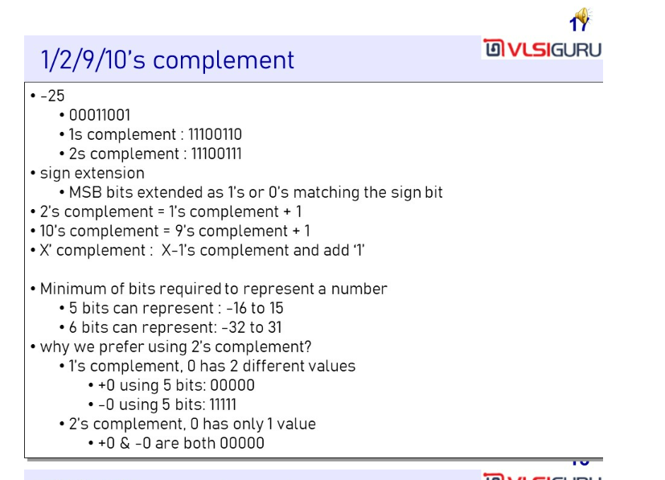

Slide 29
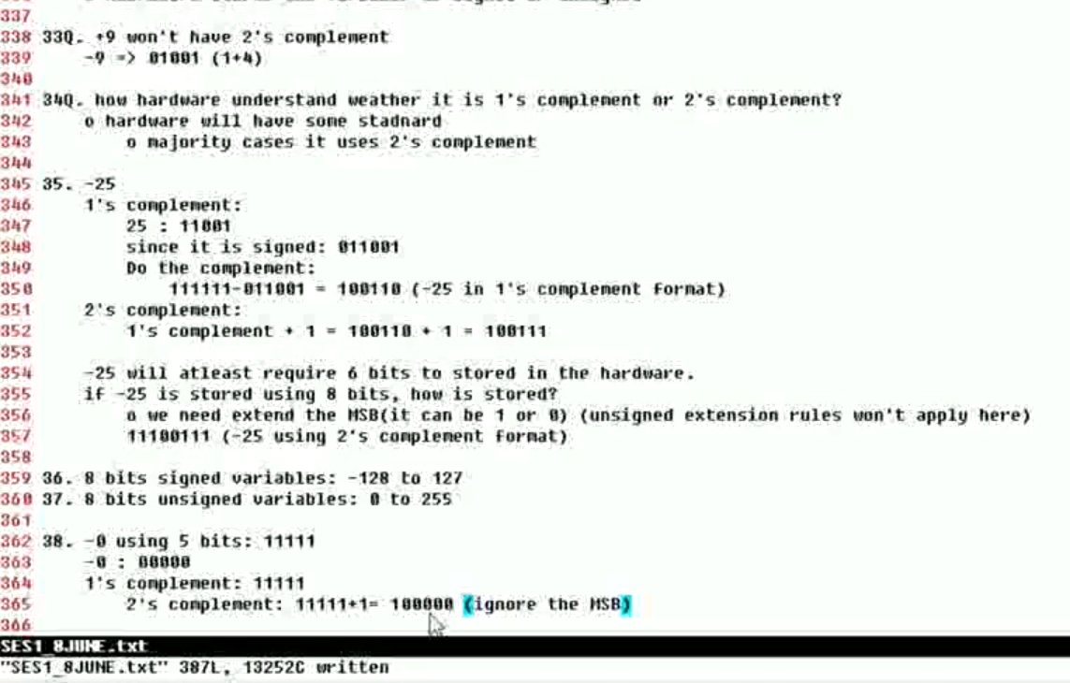
Signed no subtraction - Read Carefully !!

Slide 30
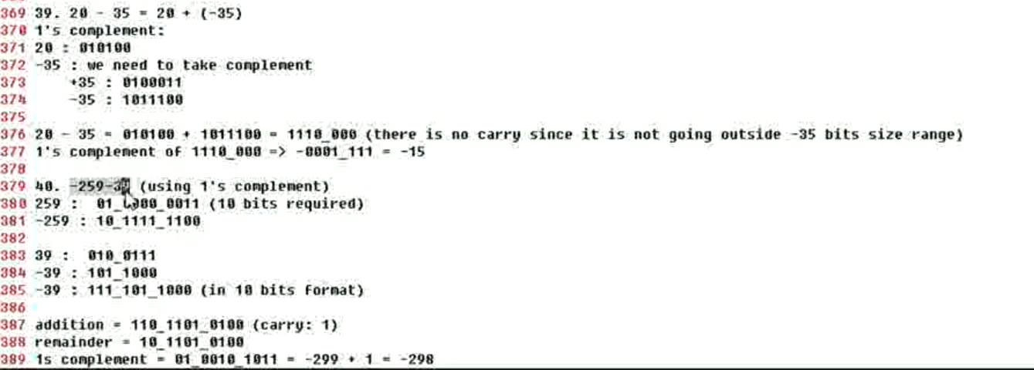
Signed no subtraction - Read Carefully !!

Slide 31
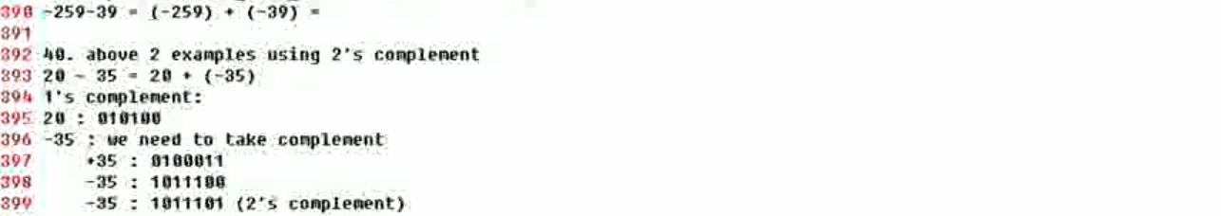
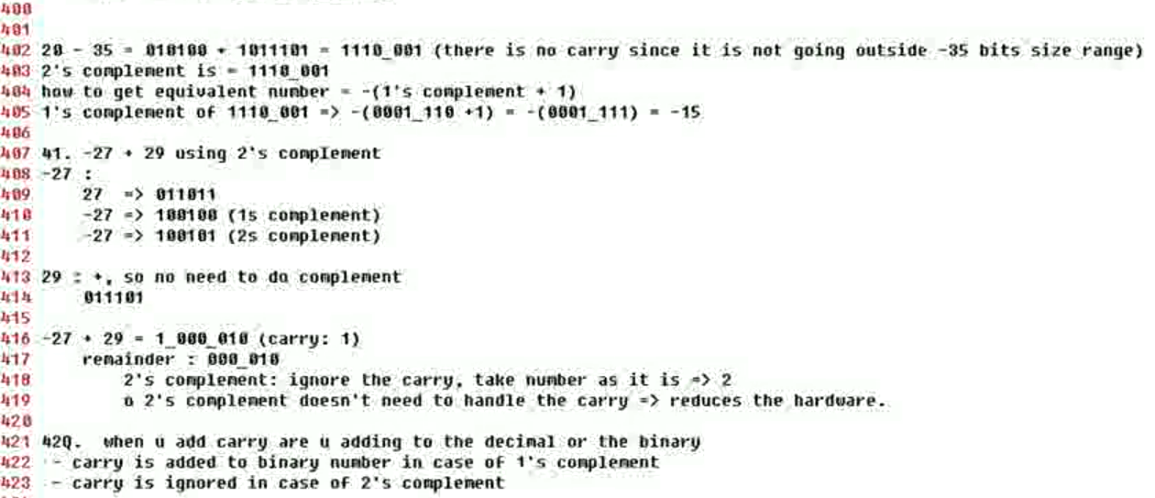
2’s complement ignores the carry hence reduced hardware and hence it is preferred over 1’s complement for arithmetic operations

Slide 32
Useful Links to understand CDC and Two-stage synchronizers
https://www.youtube.com/watch?v=YS-LHzb4djg
https://www.youtube.com/watch?v=fwh-KISWs7c
https://www.youtube.com/watch?v=ovQ5VYlEc8o&t=656s

Slide 33
Mealy and moore diagrams
For mealy = output depends on current state and input, hence it has one state less than moore
For moore = output depends on current state, no of states = no of inputs in the pattern + 1
For moore the output state will be part of a state machine diagram
For mealy output states will not be a part of state machine diagram
For mealy represent both input and output in the state machine arrow from one state to other like 0/1 as output depends on state, in.
For moore represent only input in the arrow as output depends only on state.

Slide 34
K-Maps
https://www.youtube.com/watch?v=lw1STgKUpW0
https://www.youtube.com/watch?v=YxGvrurqSOE
Very important to come up with the Boolean expression from truth table or to reduce the Boolean expression to simplified Boolean.
For SOP, 1 is filled in the k-map while for POS, 0 is filled.
For SOP, 0 in the exp is complement while for POS, 1 is complement.

Slide 35
Linting
Notice that case equality === and logical equality == have different meaning in Verilog. Similarly for != and !==.
== tests logical equality (tests for 1 and 0, all other will result in x)
=== tests 4-state logical equality (tests for 1, 0, z and x)

Slide 36


Slide 37
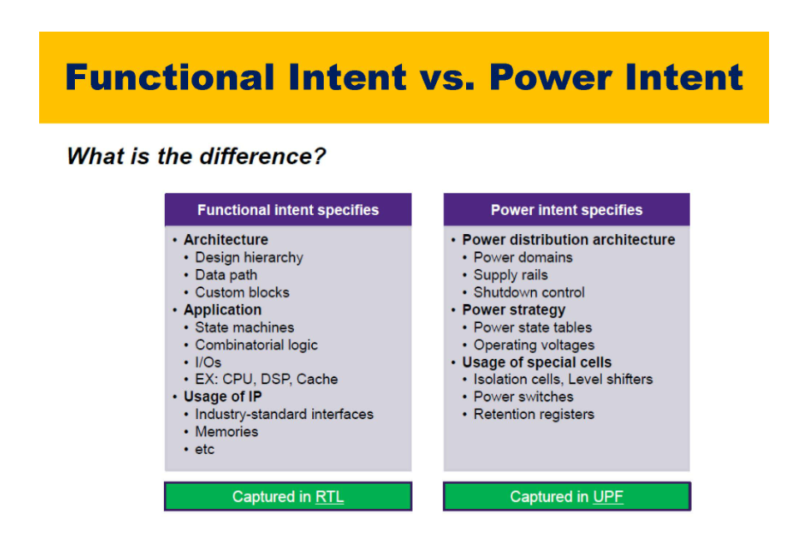

Slide 38
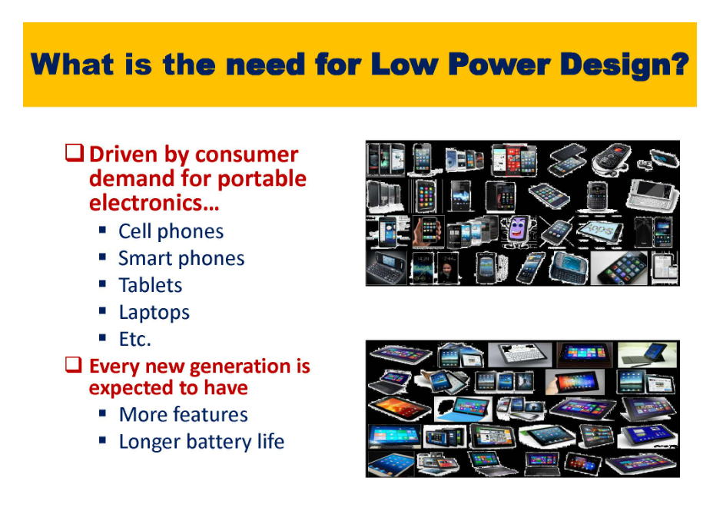

Slide 39
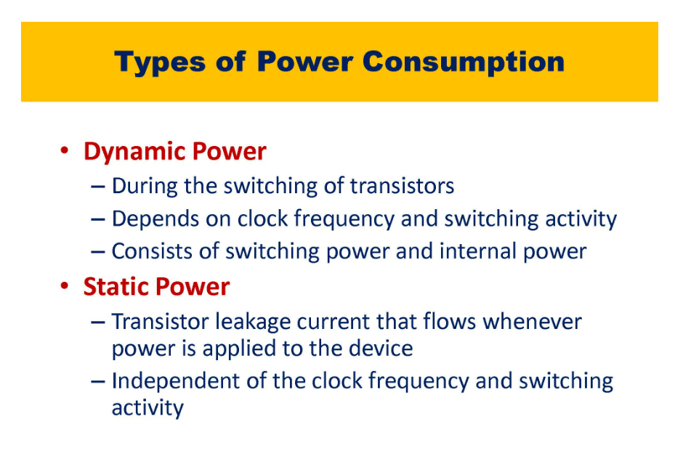

Slide 40
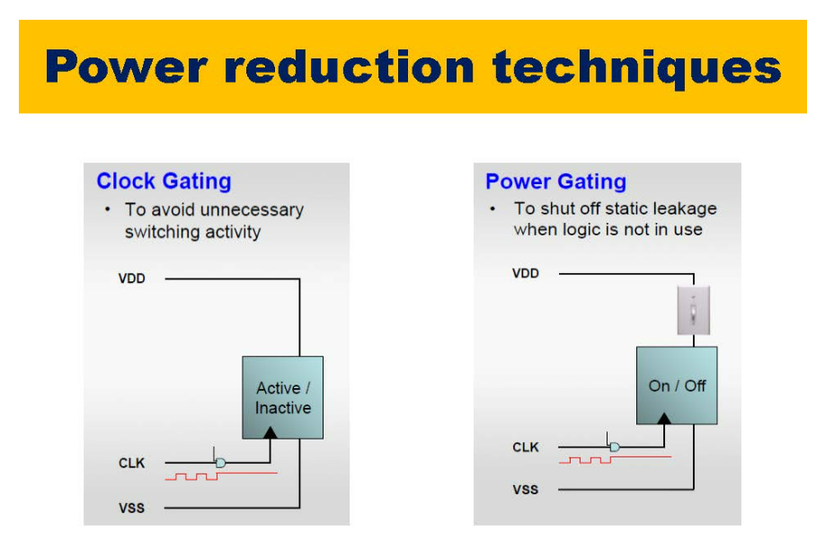

Slide 41
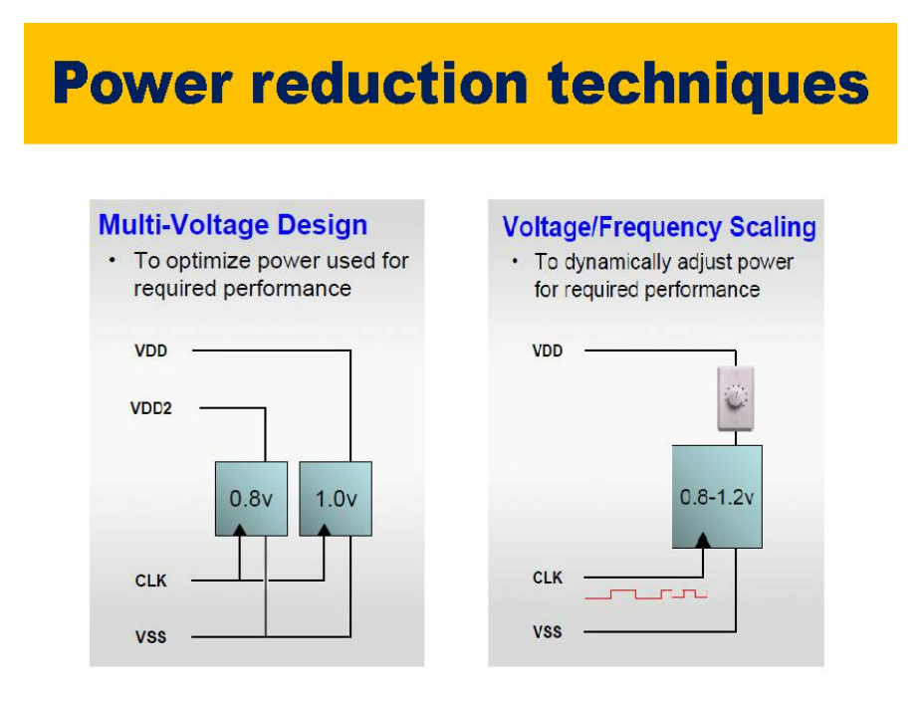
DVFS (Dynamic Voltage Frequency Scaling)

Slide 42
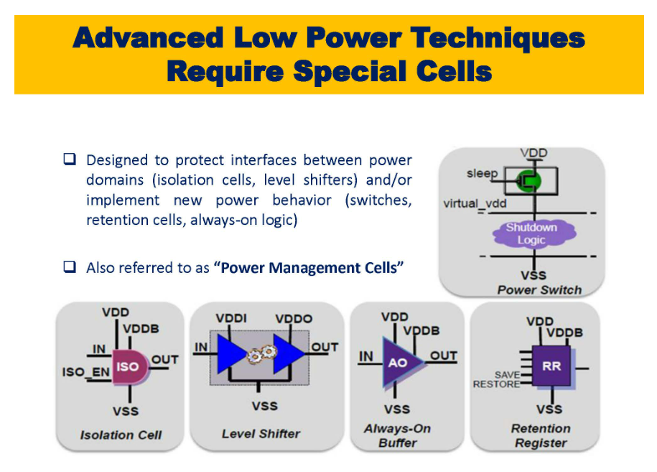

Slide 43
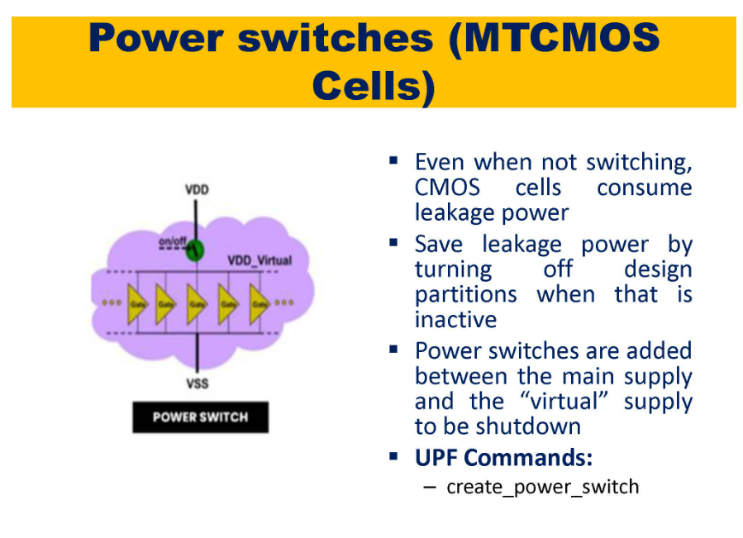
All the inputs, where to insert the special cells will be provided in UPF
In UPF we create power cells (power switches, etc). In RTL we do not know on which block is working on what voltage level, we only implemented logic but what voltage to connect to this design we have to tell in UPF.
Some domain are working on 0.7V, 1V, etc then we have to connect these domains to 0.7, 1V voltage source. All these connections is controlled in UPF.
The way we’re controlling clock domains in the SGDC file for CDC similarly we can control power domains through UPF files.
SGDC file is constraint, over here constraint is UPF files.
SGDC mentions which blocks are asynchronous. UPF tells which blocks are different power domains.
Where to insert power cells, in between which power rails we have to insert, what to control , etc all this is mentioned in UPF input files.
If you do not provide UPF file tool will assume that the whole design works on the same voltage source and that there are no power domains and hence will give no violations. Only after giving details it will throw errors like voltage shifter missing. Based on the violations we have to write constraints in the form of UPF.
In Synthesis these power cells are placed hence now we have to check the UPF w.r.t gate level netlist (initially we checked it only w.r.t RTL). We have to check UPF again after PnR.
Power Intent is captured in UPF

Slide 44
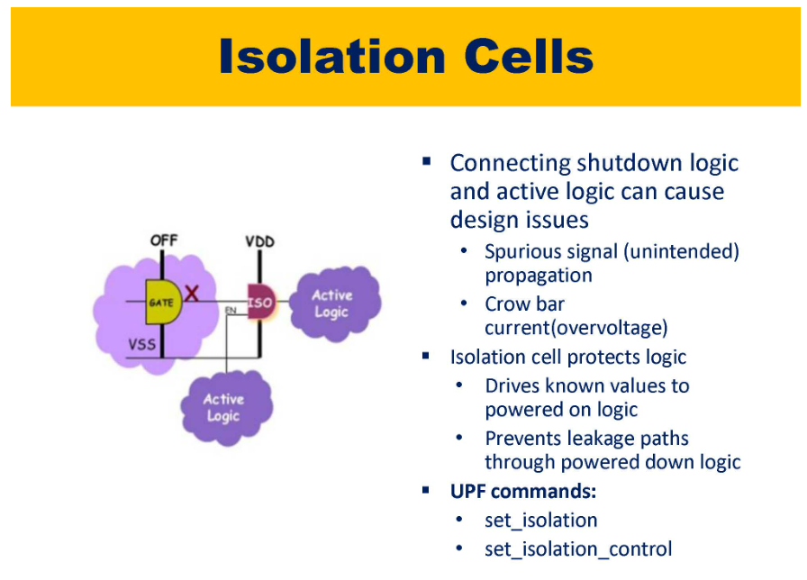
Undetermined X logic will flow to the next Active logic when shutdown logic is turned off hence we have to use Isolation Cell in between them.
Drives known value (0/1) to Active Logic before shutting off the shutdown logic.
Enable also comes from RTL power control logic.
Notice that VDD in ISO is actually VDD_BackUp because VDD is used to shut the shutdown logic Off.
Isolation Cells are used whenever signals is passing from off domain to On domain.

Slide 45
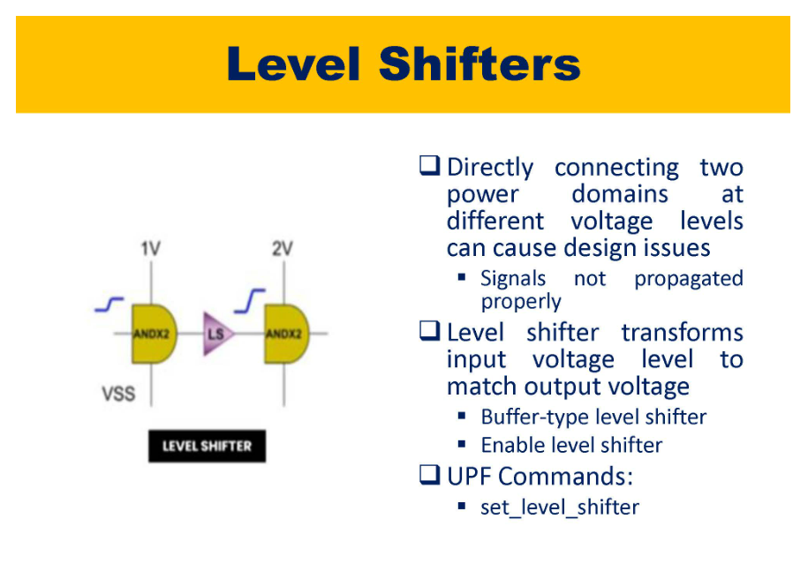
0/1 of 1V domain is 0.2/0.7V.
0/1 of 5V domain is 0.8/3.95V.
Hence 1 of 1V domain is understood as 0 for 5V domain.
Buffer-type level shifter is normal level shifter.
If Two cells of different domains are connected then anyone of them can go ON and OFF to save power. Hence when one goes OFF, isolation cells has to be used while when both are ON, level shifters has to be used. This requirement is fulfilled by “Enable level shifter ” which consists of both level shifter and isolation cells.

Slide 46
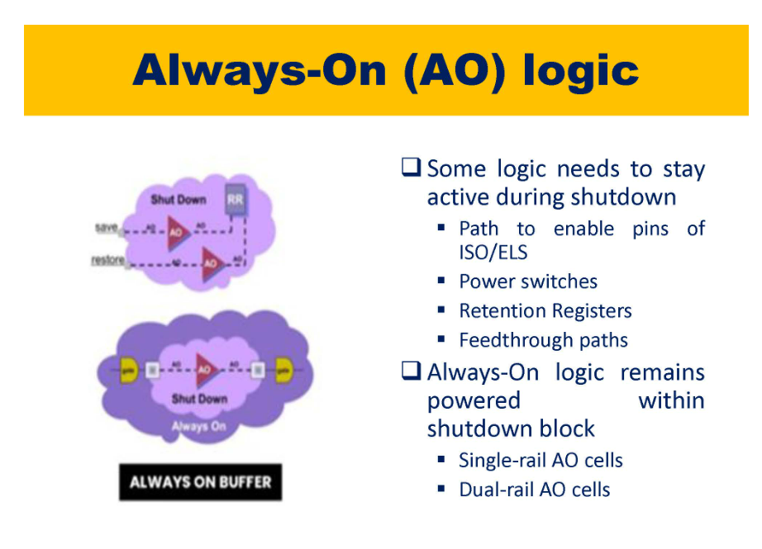
If a logic needs to be propagated from block 1 to block 3 through block 2 but say block 2 is shut off then we will not be able to pass the signal.
Always-on logic is used in these scenarios for block2 to pass the signal.
Single rail – Only VDD
Dual rail – VDD and VDD_Backup

Slide 47
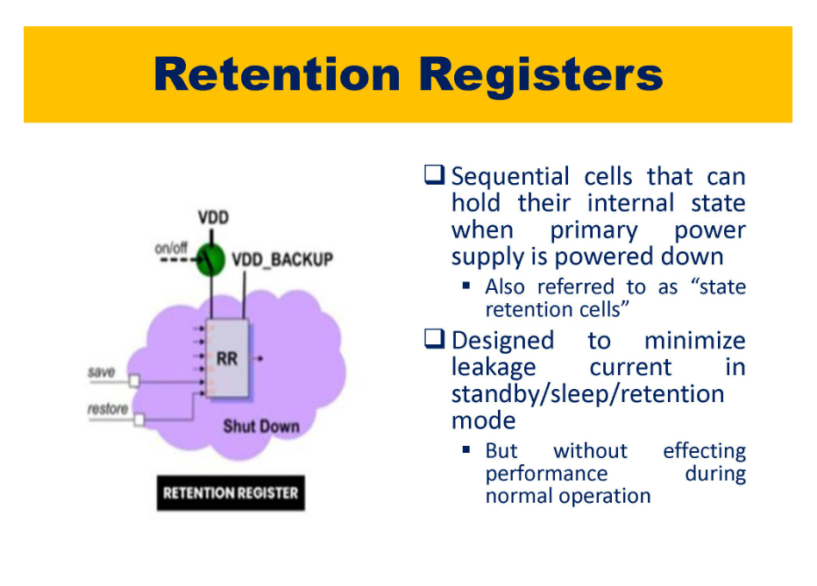
Retention Registers allows us to start from the previous data whenever the power down is happening.
Whenever you save the data register bank data is stored to shadow logic (latch).
When restore happens the data from latch is used.
Register bank is connected to VDD. VDD_BACKUP is connected to latch. Latch will hold the value.
Whenever the register bank goes OFF that is VDD is turned OFF then latch will be enabled.
Used for power gating. Whenever power gating is done we lose the logic values.
VDD_BACKUP is very low and used just to retain the logic values.

Slide 48
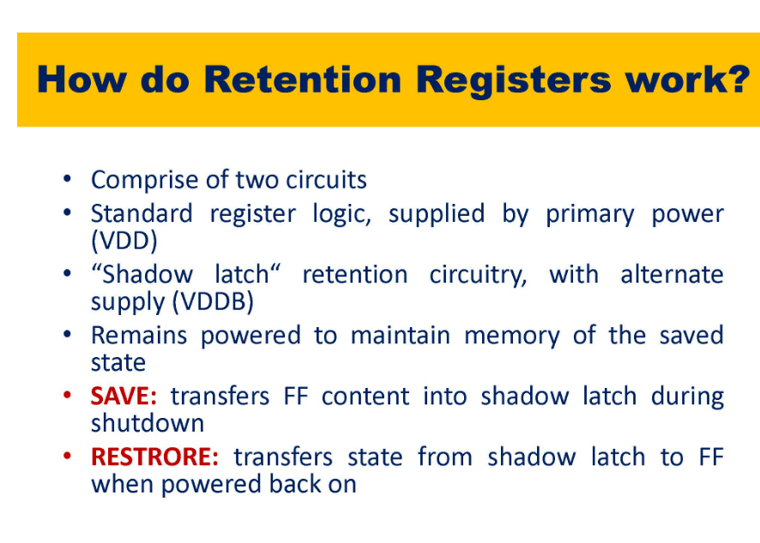

Slide 49
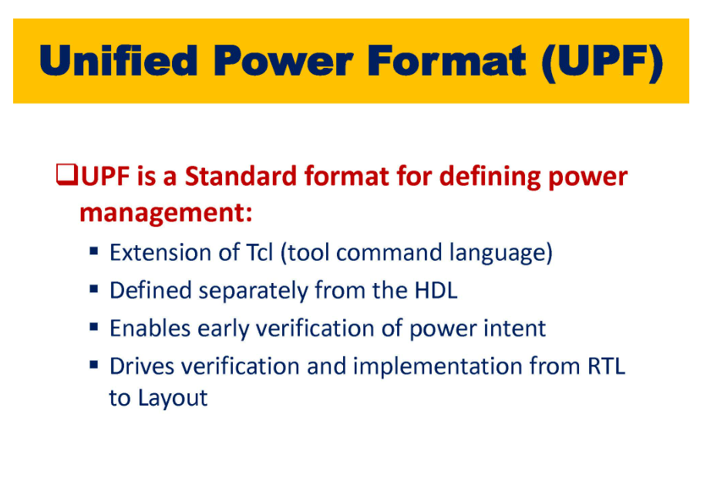
One can include UPF too at RTL level and functional verify the design.

Slide 50
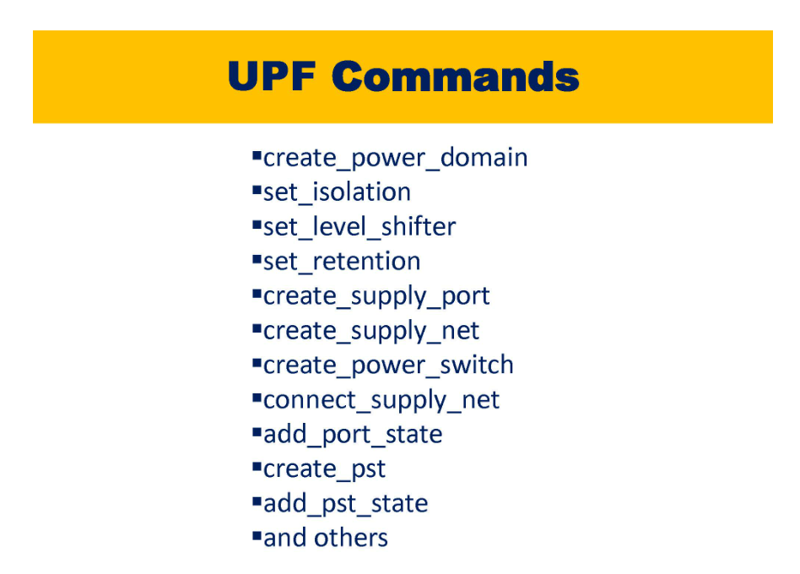

Slide 51
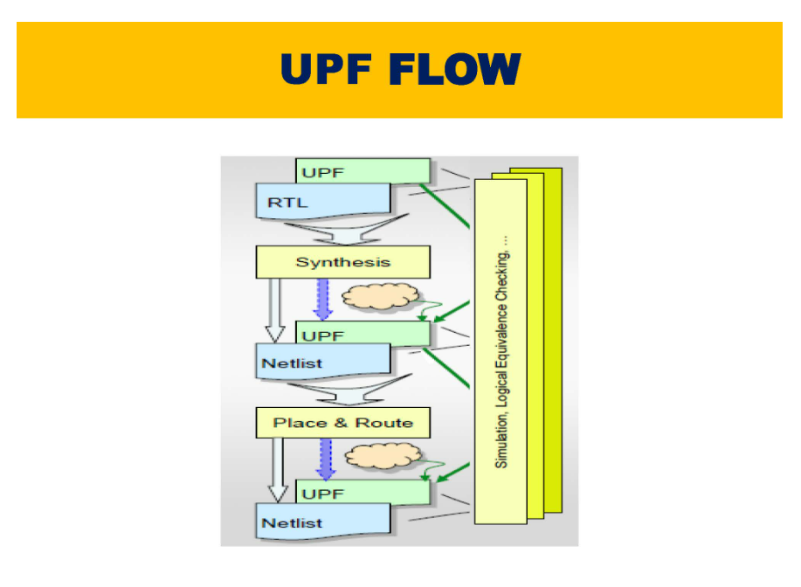
We have to check the power intent at all the stages. RTL, Synthesis, PnR

Slide 52
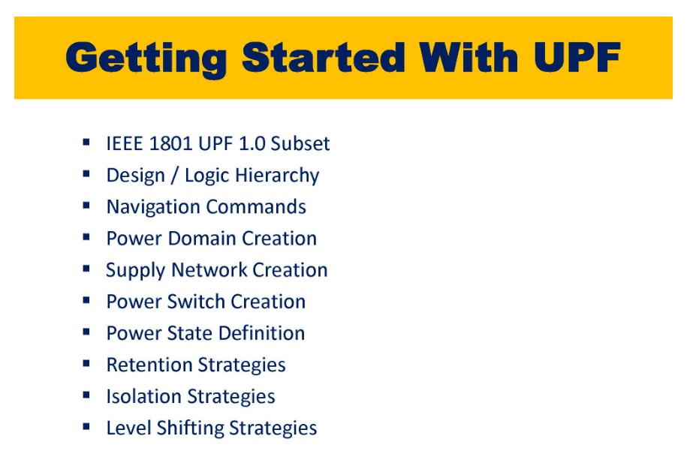

Slide 53
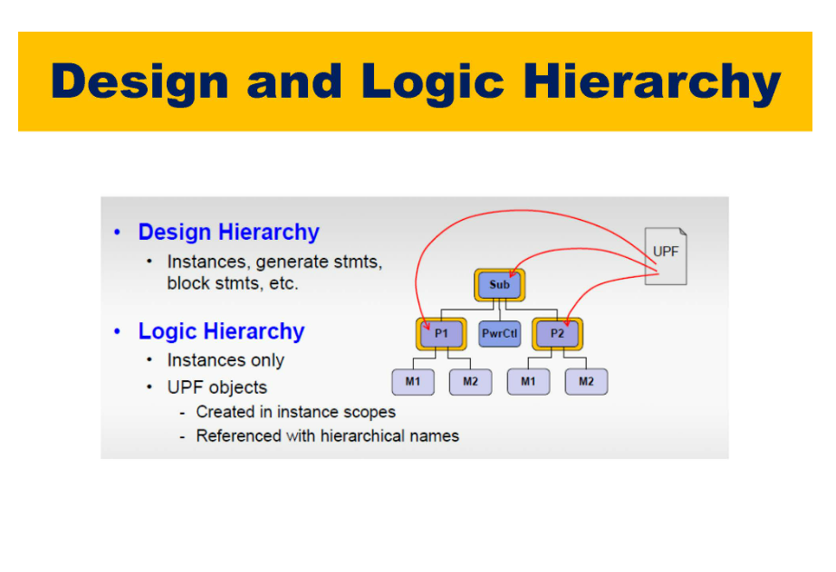
Define at what level you want to create UPF ports

Slide 54
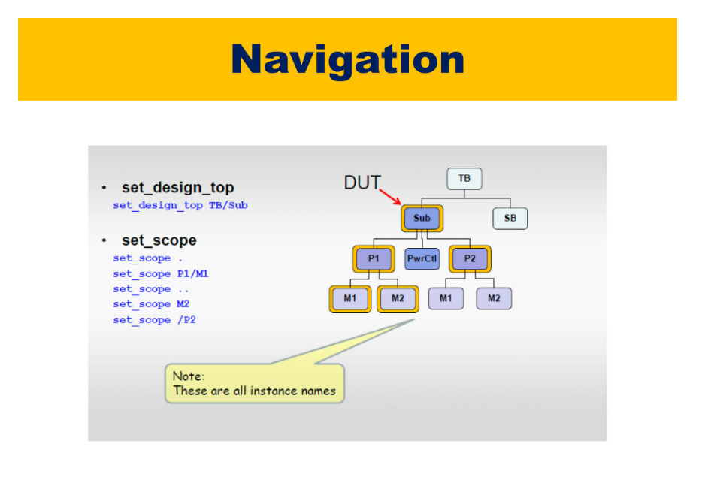
.. Means going up the hierarchy
/ means going back to the root which is Sub here
P1/M1 means applying scope to P1 and then M1

Slide 55
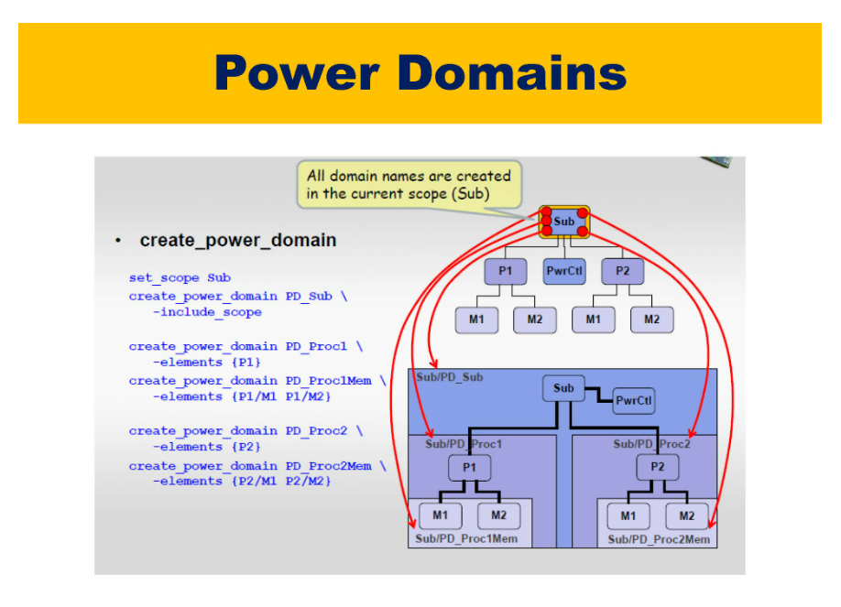
Creating Power Domain for each hierarchy.
If we do not define a particular power domain then it will take the power domain of upper hierarchy.
Example if power domain for M1, M2 is not defined it will assume the power domain of P1.

Slide 56
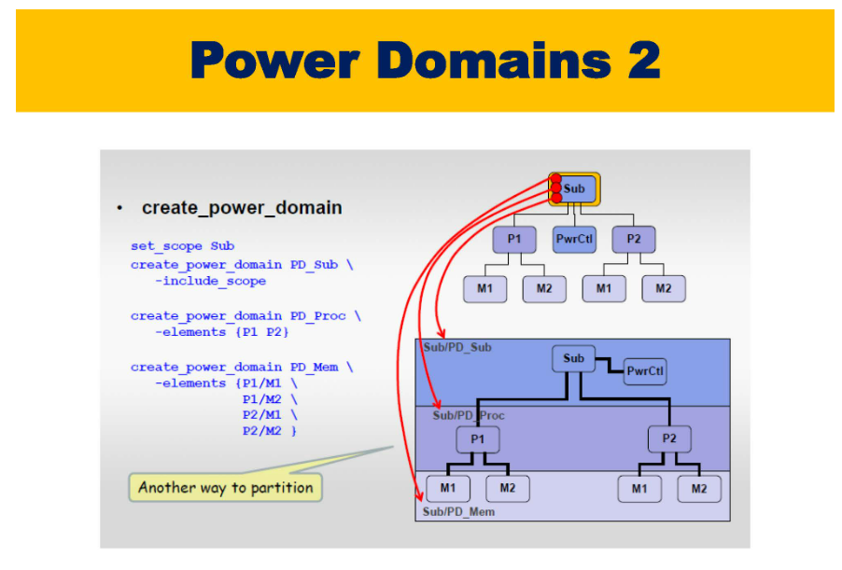

Slide 57

Which domains are getting connected to which voltage will be provided in power architecture.

Slide 58


Slide 59

UPF is input to RTL as to how the power supply will be given to the blocks
Swon, Swoff will be in swtich table where we will define voltage corresponding to On and Off

Slide 60


Slide 61

For VDD whenever state is “ON_10”, then voltage is 1.0

Slide 62


Slide 63

Definition of retention registers

Slide 64

For AND Isolation cells clamp_value is 0 while for OR Isolation cells clamp_value is 1
Notice that Enable signal for Isolation cell is in the RTL

Slide 65

Although AND is shown here in figure it is actually OR Isolation cells.
When location is parent then the isolation cell is placed in parent domain when it is self it is placed in the same domain.
mISO is RTL which is placed in RTL.

Slide 66


Slide 67

0.1V is the threshold`

Slide 68


Slide 69


Slide 70


Slide 71


Slide 72


Slide 73


Slide 74


